Slide 1
GROUP BEHAVIOR AND TEAM DEVELOPMENT

Slide 2
What is a Group?
A group is defined as two or more individuals interacting and interdependent, who have come together to achieve particular objectives.
A group can be defined as several individuals who come together to accomplish a particular task or goal.

Slide 3
Characteristics of a Group
The necessary characteristics of a group are:
Two or more people Who interact with one another
Share some common ideology
See themselves as a group. (People who interact with each other and who have a common ideology are attracted to one another.)

Slide 4
Group Dynamics
Group dynamics refers to the attitudinal and behavioral characteristics of a group.
Group dynamics concern how groups form, their structure and process, and how they function.
Group dynamics are relevant in both formal and informal groups of all types.
In an organizational setting, groups are a very common organizational entity and the study of groups and group dynamics is an important area of study in organizational behavior.

Slide 5
Group dynamics refers to the attitudinal and
behavioural characteristics of a group.
The social process by which people interact in
a group environment.
The influences of personality, power and
behavior on the group process.

Slide 6
Why it is important in organization
In an organizational setting, groups are very common
The study of groups and group dynamics is an important area of study in organizational behavior.

Slide 7
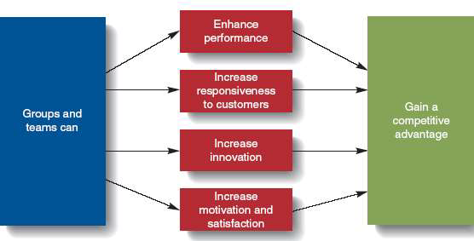

Slide 8
Groups have many motivational aspects
Group members are more likely to participate in decision-making and problem-solving activities leading to empowerment and increased productivity.
Groups complete most of the work in an organization
Thus , the effectiveness of the organization is limited by the effectiveness of its groups.

Slide 9
PHYSICAL CONDITIONS THAT INFLUENCE GROUP DYNAMICS
Seating
Size
Membership

Slide 10
STAGES OF GROUP DEVELOPMENT
Mutual Acceptance
Decision Making
Motivation and Commitment
Control and Sanction

Slide 11
Mutual Acceptance
Mutual acceptance is the first stage in a group's development. In this stage, the focus is on the interpersonal relations among the members.
Members assess one another with regard to trustworthiness, emotional comfort, and acceptance.
Power, influence, and authority issues may also emerge at this point, if strong personalities immediately attempt to dominate other group members or dictate the group's agenda. This authority issue is also an interpersonal issue related to trust and acceptance.
Once team members establish a comfortable level of mutual trust and acceptance, they can focus their attention on the work of making decisions.

Slide 12
DECISION MAKING
Planning and decision-making occur during the second stage of a group's development. The focus turns from interpersonal relations to decision-making activities related to the groups' tasks, including defining the tasks and how to accomplish them. This second stage may be thought as the planning stage in a group's development. In addition, the issue of authority often begins to surface during this stage, especially if it did not surface during the first stage. Authority questions to be resolved include: Who is responsible for which aspects of the group's work? How do individuals take leadership roles within groups? How do group members share resources and take turns?

Slide 13
Motivation and Commitment
In the third stage of development, the group has largely resolved the interpersonal and task issues.
Members' attention is directed to self-motivation and the motivation of other group members for task accomplishment. Some members focus on the task of initiating activity and ensure that the work of the group really gets moving.
Other members contribute to the group through maintenance functions such as supporting, encouraging and recognizing the contributions of their teammates or through establishing the standards that the team may use in evaluating its performance.

Slide 14
The emphasis during the third stage of group development is on execution and achievement, whether through a process of questioning and prodding or through facilitation and workload sharing.
If key decisions or plans established in the second stage of development need to be revisited, they are. However, this is only done in the context of getting the work done

Slide 15
Control and Sanctions
In its final stage of development, a group has become mature, effective, efficient and productive unit. The group has successfully worked through necessary interpersonal, task, and authority issues.

Slide 16
Types of Groups

Slide 17
FORMAL GROUPS
Established by an organization to achieve organizational goals.
May take the form of
Command groups
Task groups
Functional groups.

Slide 18
COMMAND GROUPS
Are specified by the organizational chart and often consist of a supervisor and the subordinates that report to that supervisor.
An example of a command group is an academic department chairman and the faculty members in that department.

Slide 19
TASK GROUPS
Consist of people who work together to achieve a common task.
Members are brought together to accomplish a narrow range of goals within a specified time period.

Slide 20
FUNCTIONAL GROUP
Created by the organization to accomplish specific goals within an unspecified time frame.
They remain in existence after achievement of current goals and objectives.
Example : a marketing department

Slide 21
INFORMAL GROUPS …
They are created for purposes other than the accomplishment of organizational goals and do not have a specified time frame.
Informal groups can have a strong influence in organizations that can either be positive or negative.
Unofficial or emergent groups that evolve in the work setting to gratify a variety of member needs not met by formal groups.

Slide 22
INFORMAL GROUPS …
Types
Interest group
Friendship group
Reference group

Slide 23
INTEREST GROUPS
Usually continue over time and may last longer than general informal groups.
Members of interest groups may not be part of the same organizational department but they are bound together by some other common interest.
The goals and objectives of group interests are specific to each group and may not be related to organizational goals and objectives.

Slide 24
FRIENDSHIP GROUPS
Are formed by members who enjoy similar social activities, political beliefs, religious values, or other common bonds.
Members enjoy each other's company and often meet after work to participate in these activities.

Slide 25
REFERENCE GROUP
A type of group that people use to evaluate themselves.
According to Cherrington, the main purposes of reference groups are social validation and social comparison.
Social validation allows individuals to justify their attitudes and values while social comparison helps individuals evaluate their own actions by comparing themselves to others.

Slide 26
REFERENCE GROUP…
Reference groups have a strong influence on members' behaviour.
By comparing themselves with other members, individuals are able to assess whether their behaviour is acceptable and whether their attitudes and values are right or wrong.

Slide 27
It shapes the behaviour of members in a work group
Predict individual behaviour within the group
Predict performance of the group

Slide 28
Group properties
Roles
Norms
Status
Size
Cohesiveness

Slide 29
Roles
A set of expected behaviour patterns attributed to someone occupying a given position in a social unit.
• We are required to play a number of diverse roles
• Different group impose different role requirements on individuals

Slide 30
Roles
Role identity
• Certain attitudes and behaviours consistent with a role.
• Have the ability to shift roles as per the need of the situation.

Slide 31
Roles
Role Perception
• An individual’s view of how he or she is supposed to act in a given situation.
Roles Expectation
• How others believe a person should act in a given situation.
Role conflict
• A situation in which an individual is confronted by divergent role expectations.

Slide 32
Norms
Acceptable standards of behaviour within a group that are shared by the group’s member.
"Group norms are the informal rules that groups adopt to regulate and regularize group members’ behavior”.
Groups manage to influence both ambiguous and unambiguous situations and therefore people find it safer to agree with others' opinions and conform to social norms.

Slide 33
Status
• A socially defined position or rank given to groups or group members by others. What determines status?
• Status derived from one of three sources:
The power a person wields over others
A person’s ability to contribute to group’s goals
Individual’s personal characteristics

Slide 34
Size
Does the size of a group affect the group’s overall behavior ?
Answer is : Yes.
Smaller groups are faster at completing task.
Large groups are good for gaining diverse input and problem solving Other conclusions:
Odd number groups do better than even.
Groups of 7 or 9 perform better overall than larger or smaller groups.

Slide 35
GROUP COHESIVENESS
Group Cohesion - interpersonal attraction binding group members together
Cohesiveness refers to the bonding of group members and their desire to remain part of the group.
Many factors influence the amount of group cohesiveness.
Generally speaking, the more difficult it is to obtain group membership the more cohesive the group.

Slide 36
FACTORS PROMOTING COHESIVENESS
Similarity of work
Physical proximity in the workplace
The work-flow system
Structure of tasks
Size of group (smaller rather than larger)
Threats from outside
The prospect of rewards
Leadership style of the manager
Common social factors (age, race, social status etc.)

Slide 37
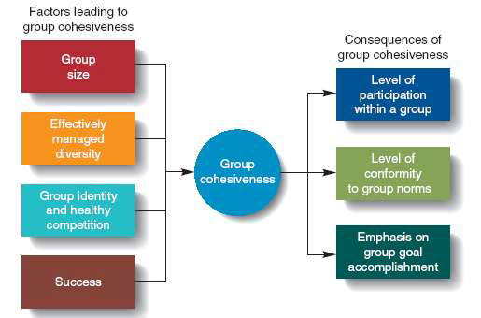

Slide 38
Theories of group formation
Propinquity Theory
Homan’s theory
Balance Theory
Exchange Theory

Slide 39
Propinquity Theory
The most basic theory explaining affiliation is propinquity.
This interesting word simply means that individuals affiliate with one another because of spatial or geographical proximity.
In an organisation employees who work in the same area of the plant or office or managers with offices close to one another would more probably form into groups than would those who are not physically located together.

Slide 40
Propinquity Theory
The drawback of this theory is that it is not analytical and does not begin to explain some of the complexities of group formation.
Some more theoretical and practical reasons need to be explored.

Slide 41
Homan’s theory
George C. Homans “the more activities persons share , the more numerous will be their interactions and the stronger will be their shared activities and sentiments; and the more sentiments persons have for one another, the more will be shared activities and interactions.”
It is based on three concepts:
Activities,
Interactions
Sentiments
They are directly related to each other.
The members share activities and interact with one another not just because of physical proximity, but also to accomplish group goals.
The key element is interaction because of which they develop common sentiments for one another.

Slide 42
Balance Theory
According to Theodore Newcomb “persons are attracted to one another on the basis of similar attitudes towards commonly relevant objects and goals”.
Once a relationship is formed, it strive to maintain a systematical balance between the attraction and the common attitudes.
If an imbalance occurs, attempts are made to restore the balance. If the balance cannot be restored, the relationship dissolves.
Both propinquity and interaction play a role in the balance theory.
There must be a balance in the relationship between the group members for the group to be formed and for its survival.

Slide 43
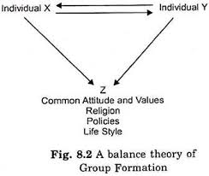

Slide 44
Exchange Theory
Based on reward-cost outcomes of interaction between people.
To be attracted towards a group, a person thinks in terms of what he will get in exchange of interaction with the group members.
A minimum +ve level (reward > cost) of an outcome must exist in order for attraction or affiliation to take place.
Rewards gratify needs and costs incur anxiety, frustrations, embarrassment, etc.
Propinquity, interaction and balance theory all have roles in the exchange theory.

Slide 45


Slide 46


Slide 47
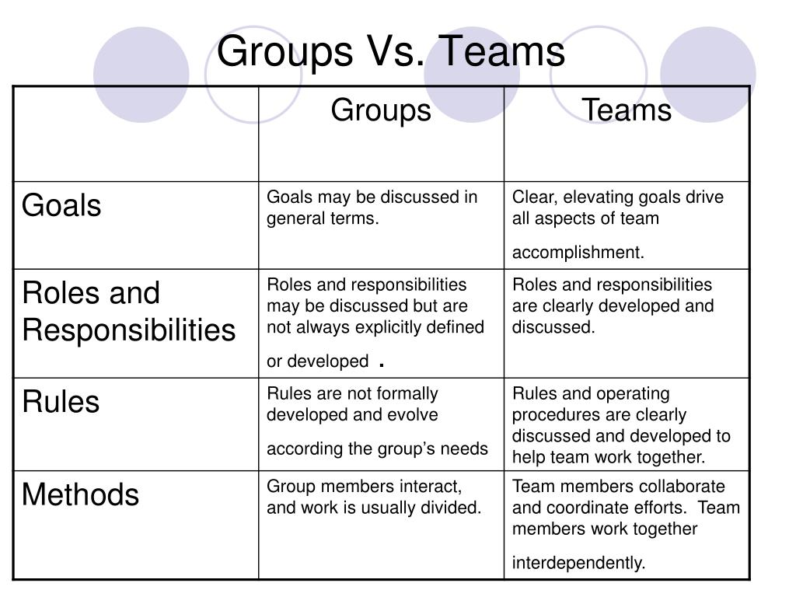

Slide 48
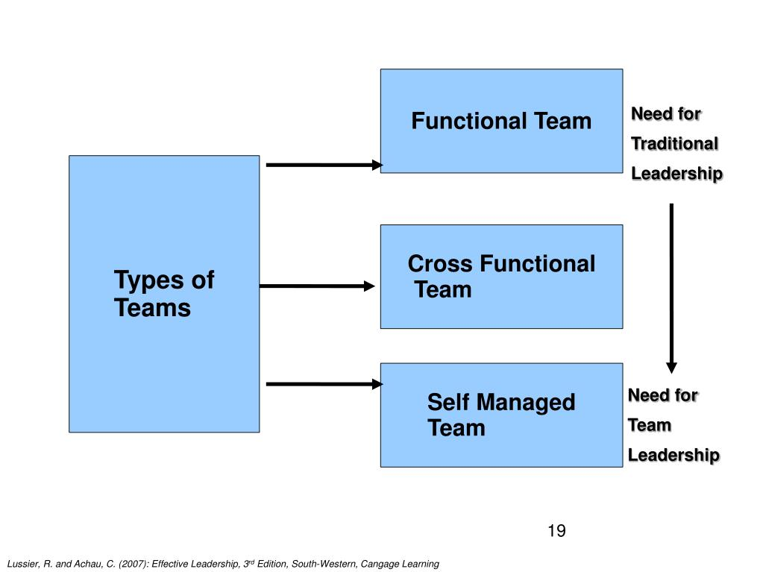
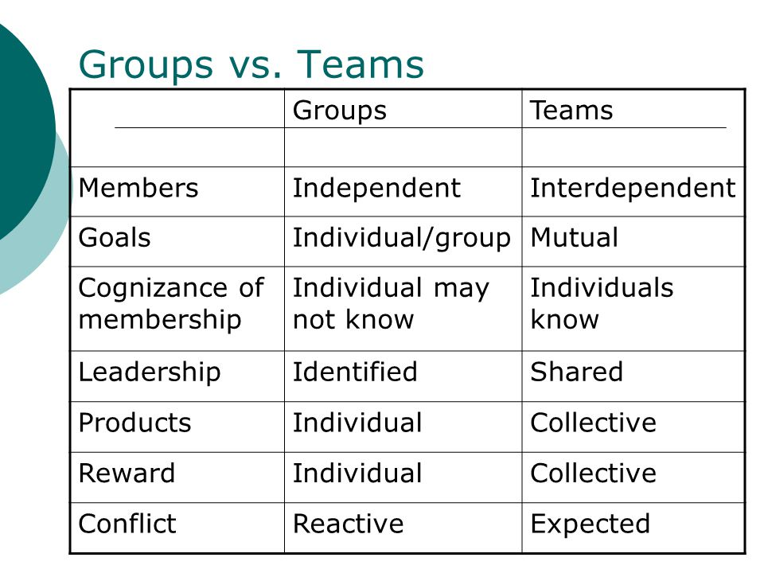

Slide 49
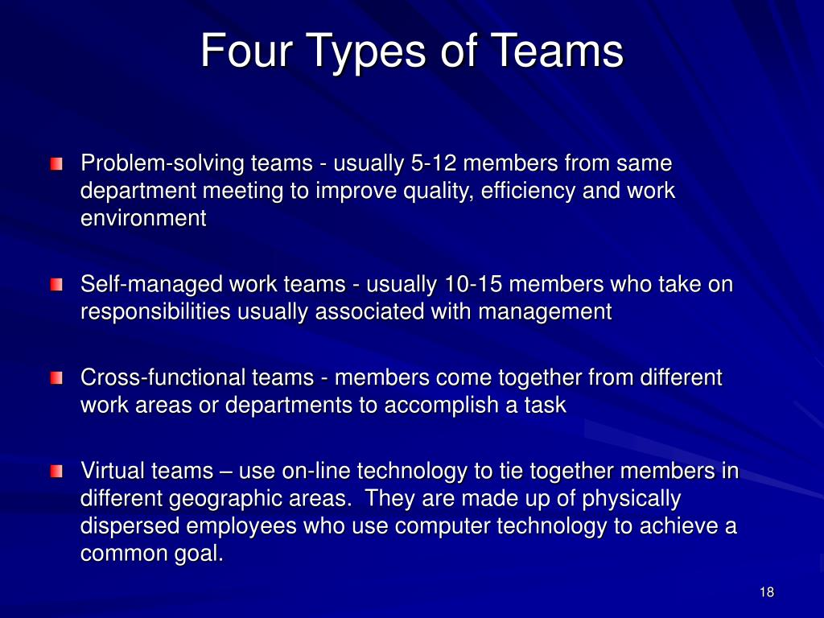
Types of Work Team

Slide 50
PROBLEM SOLVING TEAM
These types of teams are usually temporary and focus on solving a specific issue.
For example, after the 2008 financial crisis, several organizational task force teams and governmental committees were created to come up with solutions to help the country climb out of a steep recession. Once guidelines were set in place and plans were formed, the task forces and committees were disbanded.

Slide 51
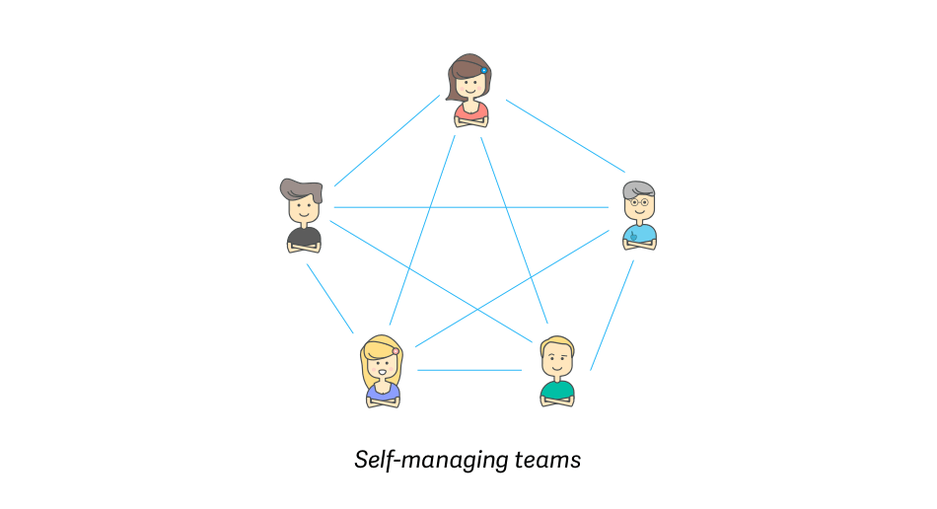
SELF-MANAGED TEAMS
Members of self-managed teams are employees of the same organization who work together, and even though they have a wide array of objectives, their aim is to reach a common goal.
There is no manager nor authority figure, so it is up to members to determine rules and expectations, to solve problems when they arise, and to carry shared responsibility for the results.

Slide 52
SELF-MANAGED TEAMS
ADVANTAGES:
Autonomy improves employee motivation;
Team members can manage their own time and handle tasks when it suits them;
You don’t have to pay for an office;
Shared responsibility instills pride in team accomplishments.
DISADVANTAGES:
The lack of hierarchical authority can put personal relationships over good judgment;
It can lead to conformity that suppresses creativity and critical thinking;
An added layer of responsibility is time-consuming and requires skills that some people simply don’t have;
Training time and costs are higher due to a broader scope of duties.

Slide 53
CROSS FUNCTIONAL TEAM
Cross functional teams are groups consisting of people from different functional areas of the company - for example, marketing, product, sales, and customer success.
These can be working groups, where each member belongs to their functional team as well as the cross functional team, or they can be the primary structure of your organization.

Slide 54
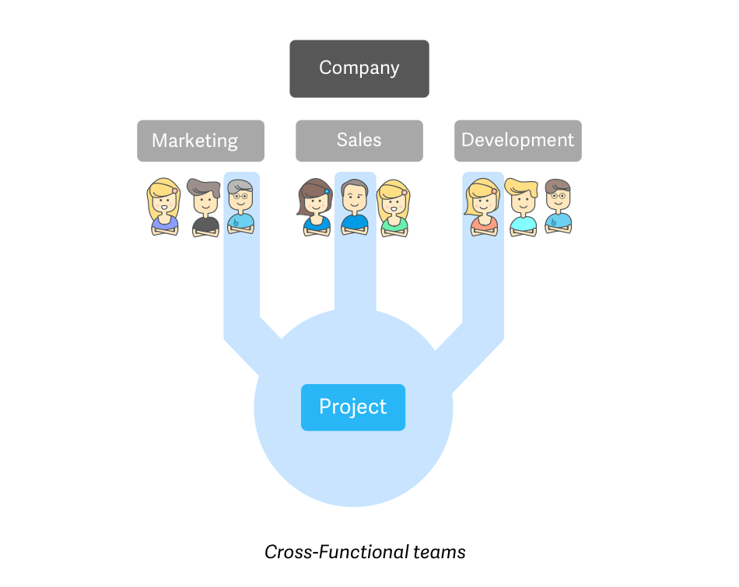
CROSS-FUNCTIONAL TEAMS
Cross-functional teams are made up of members from various departments. These teams tackle specific tasks that require different inputs and expertise. Even though cross-functional teams are becoming increasingly popular worldwide, a recent study has proven that a whopping 75% of all cross-functional teams are dysfunctional.

Slide 55
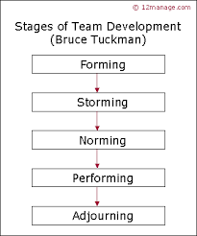

Slide 56
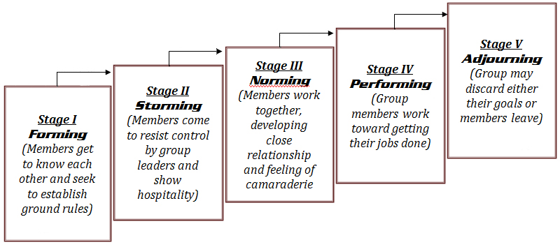

Slide 57
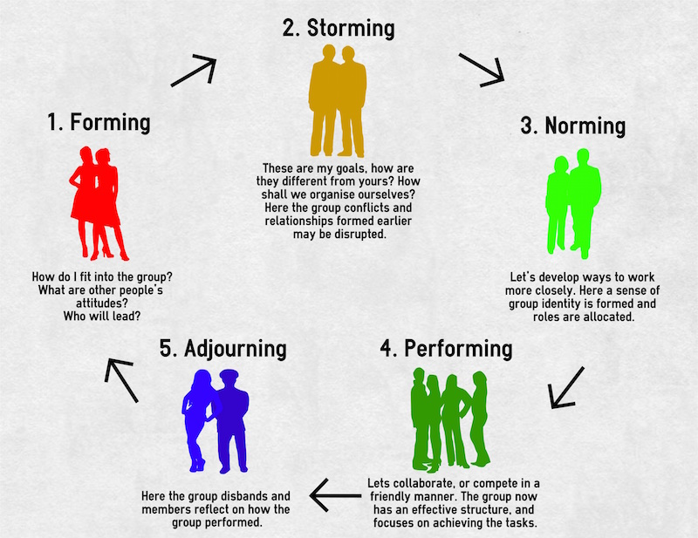
4.

Slide 58
FORMING STAGE
The first stage in team development, characterized by much uncertainty. In this, the team is formed and members meet.
They learn w hat the team opportunities and challenge will be. Members will agree on goals and assign actions for work and ground rules or team guidelines are established.
At the start, the team leader may be a member of the group, a supervisor, a manager, or a consultant who will facilitate the team-building process. Leadership will help the team to define their processes.
At this stage, the leader needs to be directive and understand the requirements for team training.
This stage is complete when the members have begun to think of themselves as a part of a team.

Slide 59
STORMING STAGE
The second stage in team development, characterized by intra-group conflict.
During the second stage, individual expression of ideas occurs and there is open conflict between members.
Members tend to focus on details rather than the issues and compete for influence.
Low trust among team members is an evident indicator of this stage. The team needs to select their desired leadership style and decision methodology.

Slide 60
The team leader can help by stressing tolerance and patience between members. The leader should guide the team process towards clear goals, defined roles, acceptable team behavior, and a mutual feedback process for team communication.
When this stage is complete, there will be a relatively clear hierarchy of leadership within the team.

Slide 61
NORMING STAGE
The third stage in team development, characterized by close relationships and cohesiveness. In the third stage, the team develops work habits that support group rules and values.
They use established tools and methods; exhibit good behaviors; mutual trust, motivation, and open communication increase; positive teamwork and team focus are apparent.
The team relationships grow and individual characteristics are understood and appropriately utilized.

Slide 62
The team leader continues to encourage participation and professionalism among the team members.
This stage is complete when the team structure solidifies and the team has assimilated a common set of expectations of what defines correct member behavior.

Slide 63
PERFORMING STAGE
The fourth stage in team development, when the team is fully functional.
The fourth stage shows high levels of loyalty, participation, motivation, and group decision-making. Knowledge sharing, cross-training, and interdependence increases.
Team is self-directing in development of plans and strategy to meet their goals and carry out work. Personal growth and sharing is encouraged throughout membership.

Slide 64
The leader becomes a facilitator aiding the team in communication processes and helping if they revert to a prior stage.
Team energy has moved from getting to know and understand each other to performing the task at hand.
Note: For permanent work groups, performing is the last stage in team development.

Slide 65
ADJOURNING STAGE
The final stage in team development for temporary groups, characterized by concern with wrapping up activities rather than performance.
For project teams, temporary committees, or task forces coming to an end, there will be a finalizing stage as they celebrate and recognize team achievement.
Then some mourning over the dissolving of the team relationship and begin planning for the change in individual work requirements.

Slide 66
During this stage, leadership needs to emphasize organization gratitude and both team and individual recognition.
For continuous work teams, there may be a higher performance level as they develop and transform as individuals and reform into revised teams.
It is important to note that continuous work teams may revert to prior stages when new people are added to the team.

Slide 67
GROUP SYNERGY vs. LOAFING
Social loafing describes the tendency of individuals to put forth less effort when they are part of a group.
Because all members of the group are pooling their effort to achieve a common goal, each member of the group contributes less than they would if they were individually responsible.

Slide 68
Synergy usually arises when two persons with different complementary skills cooperate. In business, cooperation of people with organizational and technical skills happens very often.
In general, the most common reason why people cooperate is that it brings a synergy. On the other hand, people tend to specialize just to be able to form groups with high synergy
Example: Two teams in System Administration working together to combine technical and organizational skills in order to better the client experience, thus creating synergy.

